Slide 1



total by product
View in Power BI
Last data refresh:
19/12/2021 17:24:51 UTC
Downloaded at:
19/12/2021 18:06:35 UTC

Slide 2
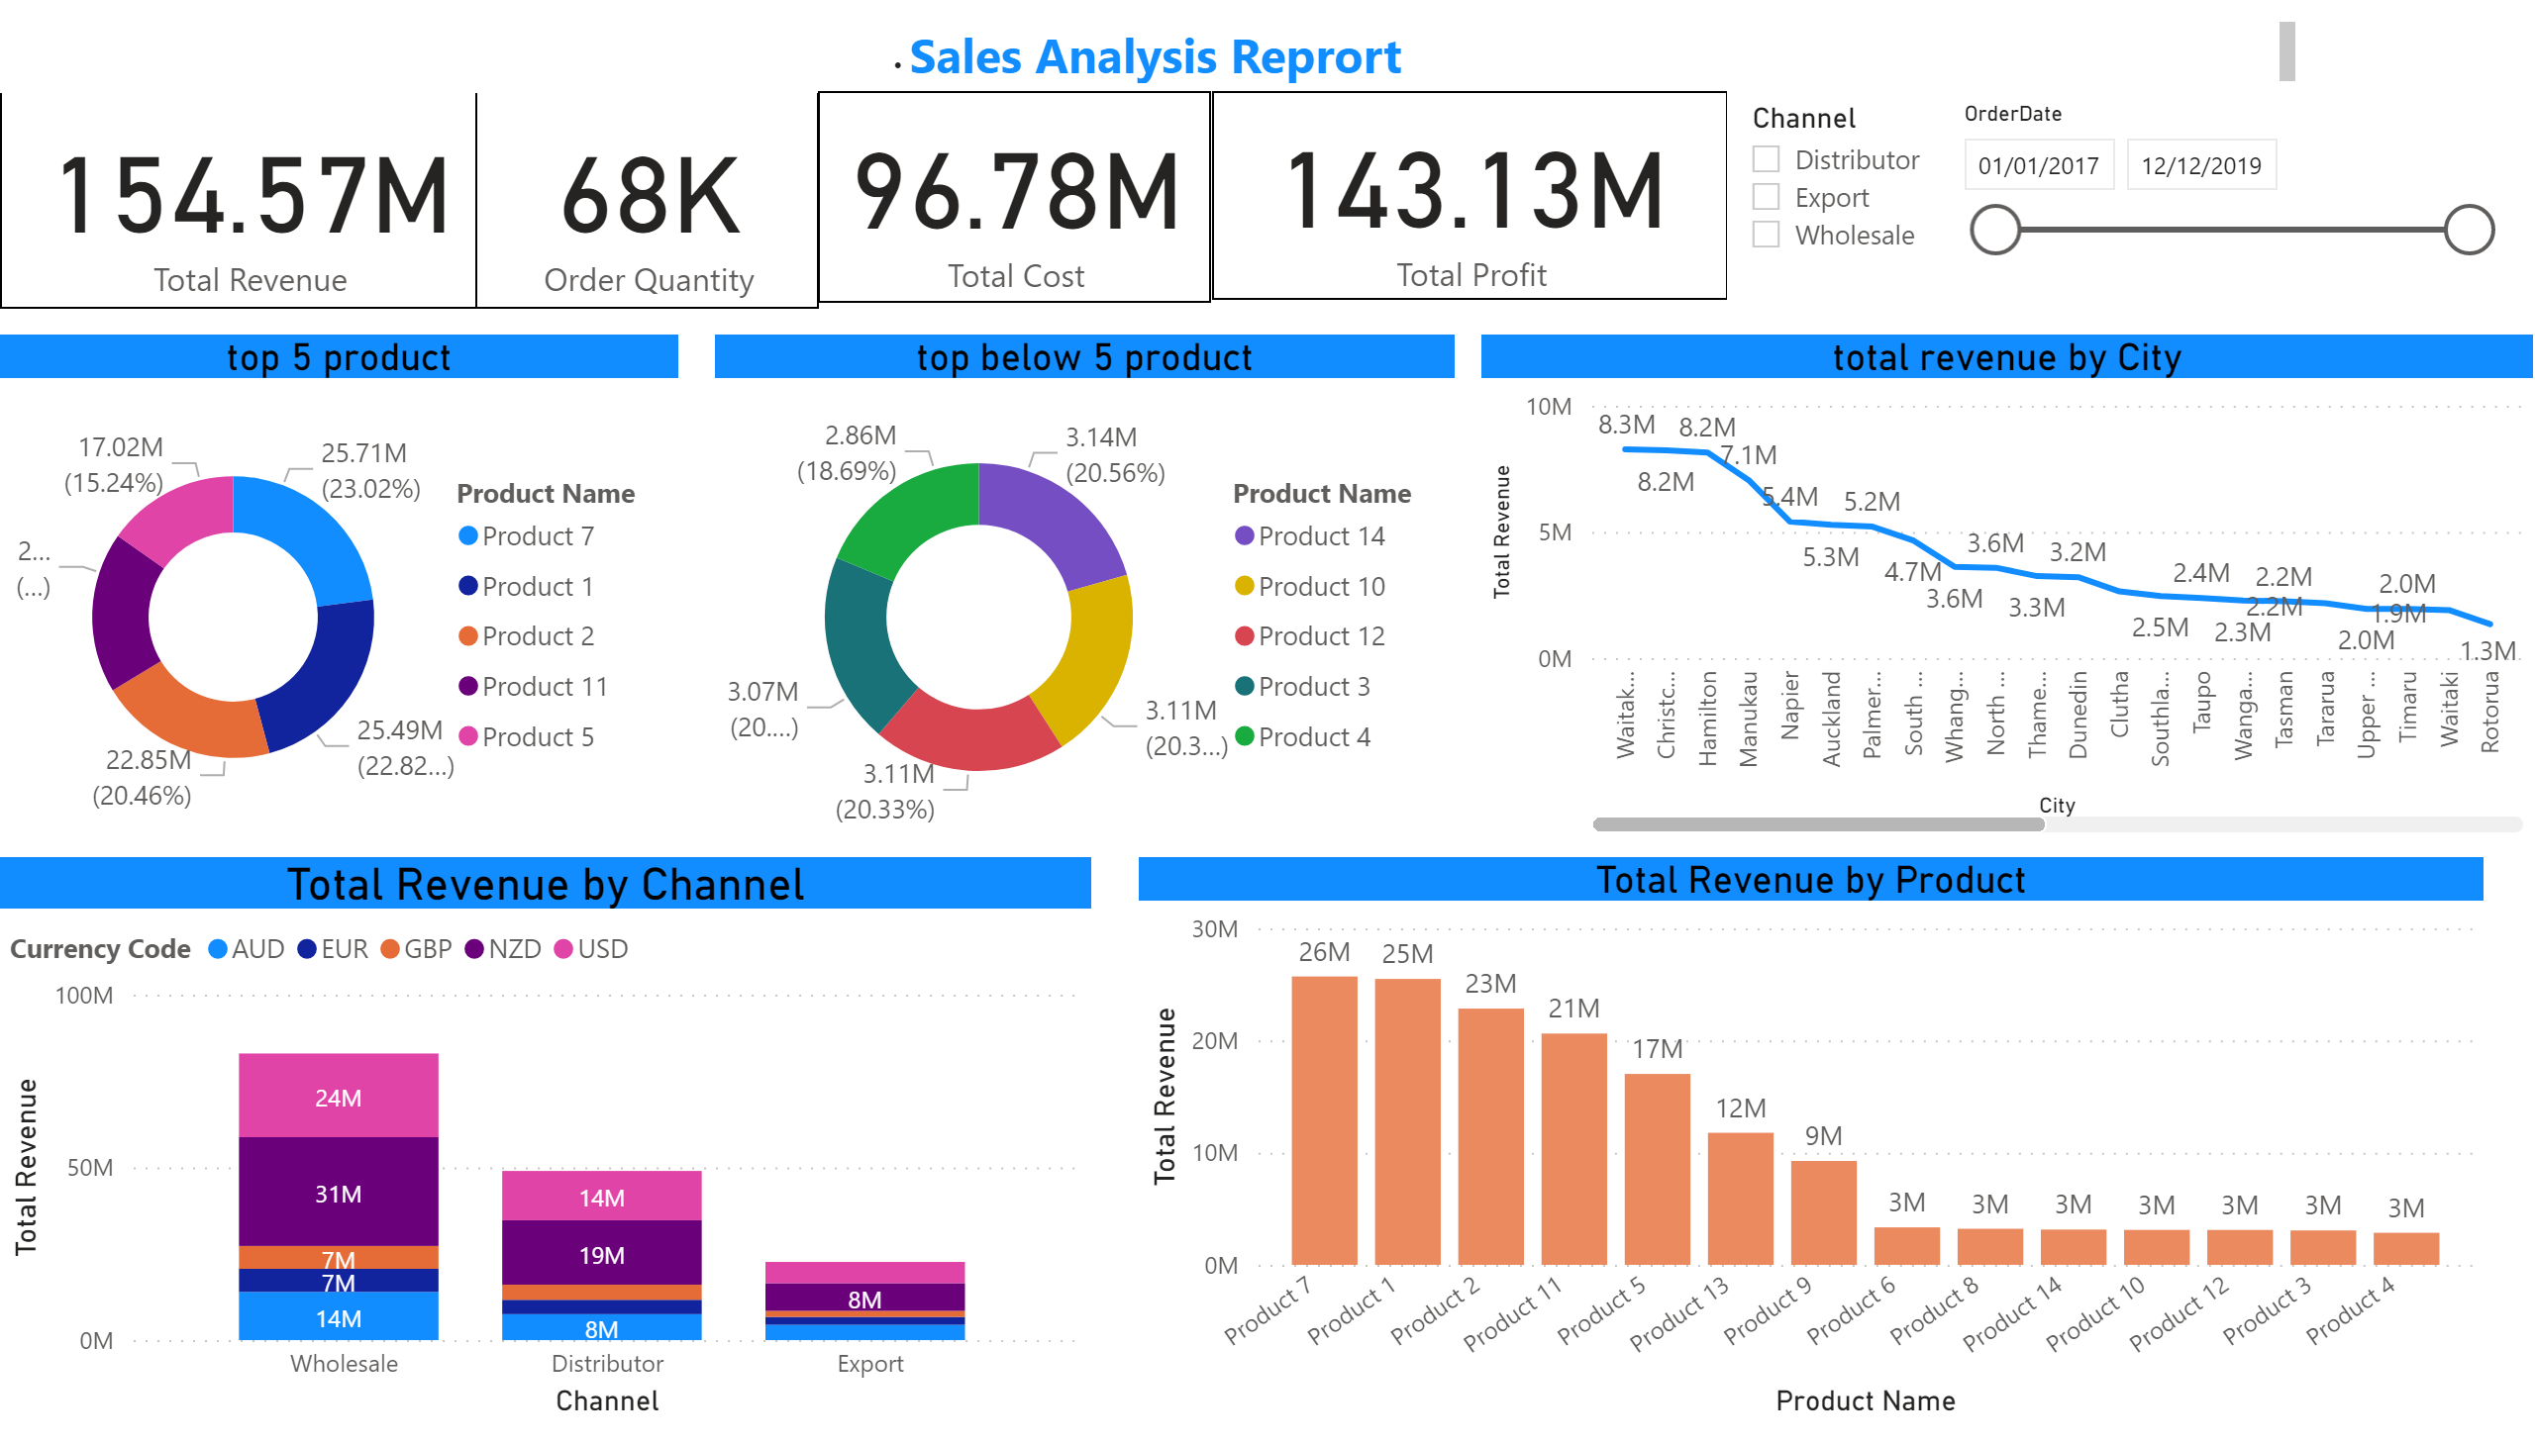
Page 1
Notes:
Total Revenue by Product
No alt text provided
Total Revenue by Channel
No alt text provided
top 5 product
No alt text provided
top below 5 product
No alt text provided
total revenue by City
No alt text provided
card
No alt text provided
card
No alt text provided
textbox
No alt text provided
card
No alt text provided
card
No alt text provided
slicer
No alt text provided
slicer
No alt text provided

